Slide 1
HL7® FHIR® Terminology
Rob Hausam MD
Part 1 – Introduction and Fundamentals

Slide 2

This presentation
Can be downloaded here:
FHIR-Terminology-Part-1-2024-04-23
Is licensed for use under the Creative Commons, specifically:
Creative Commons Attribution 3.0 Unported License
(Do with it as you wish – just give credit)
Acknowledgements: Reuben Daniels, Grahame Grieve, Lloyd McKenzie
2

Slide 3
This presentation
Based on the current official version of HL7 FHIR
FHIR Release 5 (v5.0.0)
https://hl7.org/fhir/
Particular relevant and significant differences from the prior R4B release (http://hl7.org/fhir/R4B/) will be noted
Many (or most) terminology services are anticipated to remain on R4/R4B for an indefinite period of time
3

Slide 4

Who am I?
Name: Rob Hausam MD
Company: Hausam Consulting LLC
Background:
Co-chair of Terminology Infrastructure (TI) (formerly Vocabulary) and Orders and Observations (OO) WGs
FHIR specification and Terminology Module editor
Actively involved in HL7 and terminology standards/development and modeling for 23+ years
SNOMED on FHIR project co-lead (joint project of HL7 and SNOMED International)

Slide 5
Tutorial Learning Objectives
Part 1 – Introduction and Fundamentals
Understand how coded data is represented in data types and model elements and is exchanged in FHIR resources
Understand how code systems and value sets in FHIR are defined, identified and used
Understand terminology binding and how to specify and use it correctly in FHIR models (resources and profiles)

Slide 6
Tutorial Learning Objectives
Part 2 – Searching and Services
Understand and use FHIR terminology-based search capabilities
Understand and use FHIR Terminology Service capabilities

Slide 7
Tutorial Learning Objectives
Part 3 – Advanced Topics (potential)
Further exploration of primary FHIR terminology service operations ($expand, $lookup, $validate-code, $subsumes, $translate)
Advanced terminology searching techniques
FHIR implicit value sets (SNOMED CT and other)
SNOMED CT Expression Constraint Language (ECL) in value set definitions
Code system supplements
Using terminology content in THO (terminology.hl7.org)
Submitting and managing a UTG proposal
Requesting new external (non-HL7) terminology content

Slide 8
Part 1 Topics Introduction and Fundamentals
Where to Find Terminology in FHIR
Terminology Basics
Coded Data Types
Terminology Resources
Terminology Documentation

Slide 9
where to find Terminology in FHIR

Slide 10
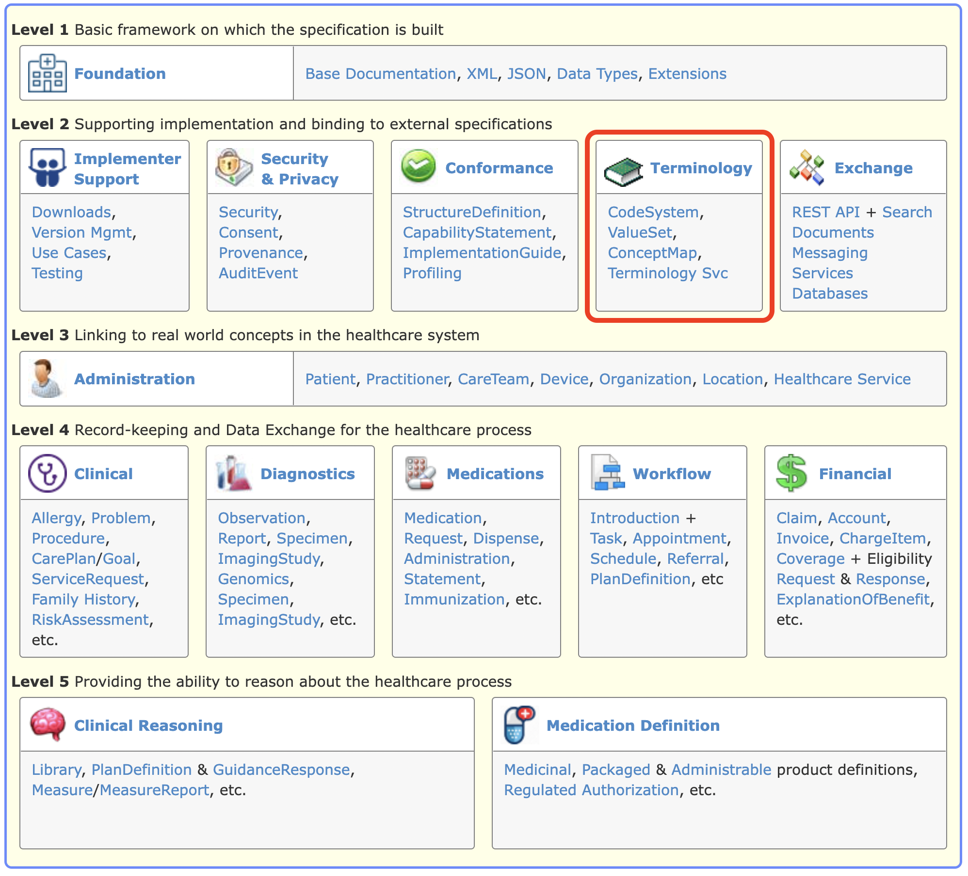
Terminology Module 1/2
Modules in FHIR
The content of the FHIR platform specification is organized as a set of modules each with a level from 1-5.
Lower levels deal with more infrastructural concerns while higher levels deal with content and reasoning.
The level 2 modules support implementation and binding to external specifications.
The Terminology Module (highlighted) is a level 2 module

Slide 11
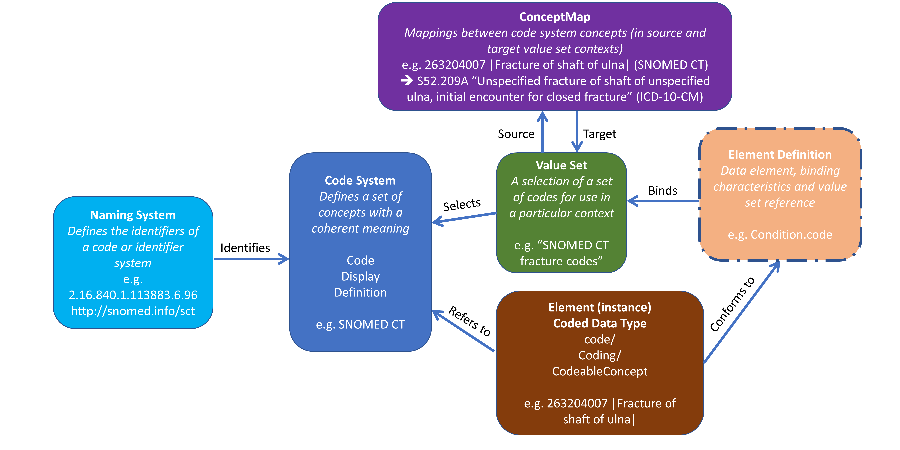
Terminology Module 2/2
The Terminology Module
Is published here: https://hl7.org/fhir/terminology-module.html
Relies on components of the Foundation, Exchange and Conformance modules
Brings together the capabilities that are used for representing and communicating coded, structured data in the FHIR core specification and profiles
Is composed of the following capabilities
Coded data types
Resources
Operations
Documentation
The FHIR Terminology Service

Slide 12

Terminologies link
Terminologies link
The link (3rd from last) in the top-level (red) navigation bar
The quick and easy way to get to the terminology content in the FHIR specification – code systems, value sets, concept maps

Slide 13
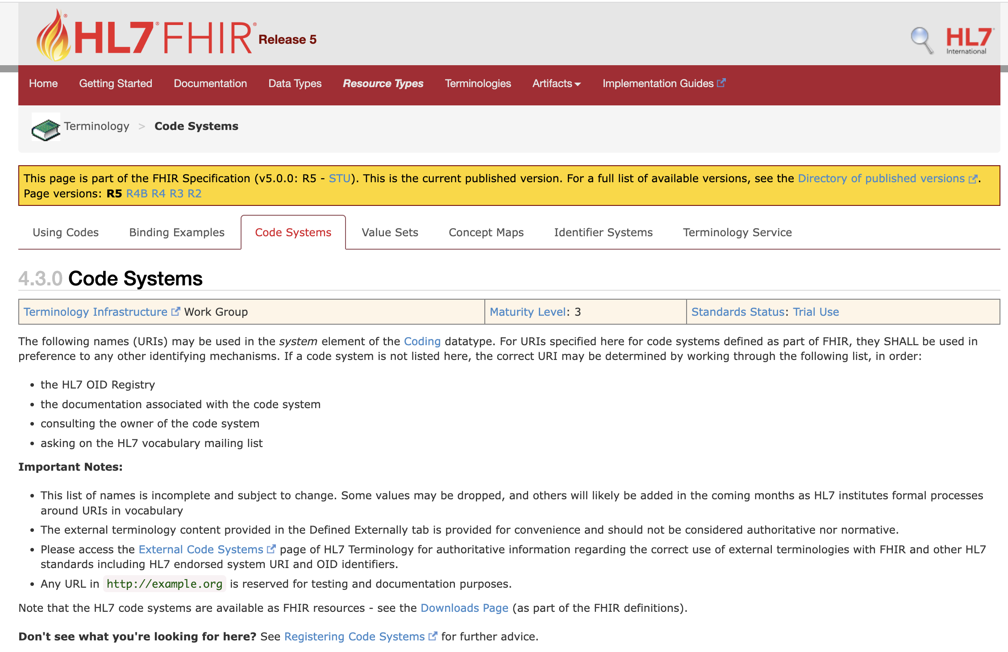

Slide 14

FHIR Zulip Chat - Terminology stream
https://chat.fhir.org/#narrow/stream/terminology

Slide 15
terminology Basics

Slide 16
Terminology basics 1/6
Concepts
A concept is a unitary mental representation of a real or abstract thing – an atomic unit of thought e.g., femur, Has or had COVID-19, aspirin, Australia, English, etc.
A concept representation is a vocabulary object that enables the manipulation of a concept. For example, in information exchange based on HL7 specifications.
A code is a concept representation published by the author of a code system as part of the code system. It is the preferred unique identifier for that concept in that code system for the purpose of communication and is used in the code property of an HL7 coded data type e.g., 71341001 (SNOMED CT™), 99349-3 (LOINC™), 1191 (RxNorm), AU (ISO 3166), en (IETF BCP 47 language tag).
A designation (or description) is a concept representation that may be published by the code system author and is a human language symbol for a concept that is intended to convey the concept meaning to a human being.

Slide 17
Terminology basics 2/6
Code systems
The context in which a concept is defined is called a code system.
A code system is a collection of uniquely identifiable concepts with associated representations, designations, associations and meanings, published by a single organization or authority.
Many code systems exist in the clinical domain, such as ICD-10™, SNOMED CT, and LOINC, in addition to code systems defined by HL7.
In addition to concepts definitions, a code system may include or support relationships between concepts, filters, mechanisms for implementing hierarchies, support for multiple languages, versions, grouping of concepts, and the capability for the composition of new concepts using a syntax or grammar.

Slide 18
Terminology basics 3/6
Code system supplements
A code system supplement is a technical artifact which can extend an existing code system through the addition of new designations and / or properties to the code system’s existing concepts
Code system supplements can not
Change or remove content in the code system
Add new concepts
Code system supplements may be defined by parties other than the code system’s owner / authority.
Supplements are generally used to address the following use cases:
Adding support for additional human languages to a code system
Adding additional properties to the code system’s concepts e.g., adding properties to concepts to support the user interface functionality

Slide 19
Terminology basics 4/6
Value sets
A value set describes a collection of concepts drawn from one or more code systems grouped together for a specific purpose (e.g., adverse reaction agent codes from SNOMED CT)
A concept in a value set may be a single concept or a post-coordinated expression
Value sets may select codes from multiple code systems and even multiple versions of the same code system
Key use cases for value sets include:
Specifying a set of codes drawn from one or more code systems, intended for use in a particular context
To link code system definitions and their use in coded elements

Slide 20
Terminology basics 5/6
Value set expansions
Expanding a value set is the process of determining the collection of codes and their descriptions suitable for data entry or validation based on the definition of a value set
The collection of codes produced by this process is known as a value set expansion
Value set expansions are usually (but not always) generated by specialized software e.g., a terminology server which is capable of evaluating the value set definition and understanding its underpinning code systems

Slide 21
Terminology basics 6/6
References to “value set”
In the absence of an explicit context, the phrase “value set” is usually taken to mean BOTH of the following:
A Value Set Definition which is a description of the set of concept representations (usually codes) that are intended for use
and
A Value Set Expansion which is the set of resulting codes from a value set expansion drawn from one or more specific code systems

Slide 22
CODED Data types

Slide 23
Coded data types 1/4
Coded data types
Are defined as part of the Data Types component of the Foundation module
Are curated by the FHIR Infrastructure (not Terminology Infrastructure) Work Group in HL7
Include the following data types:
code
Coding
CodeableConcept

Slide 24

Coded data types 2/4
The code data type
Is simply a string representing the code for a concept
The data type does not include identification of the code system nor the display name (description) of the associated concept because these are fixed elsewhere (e.g., in the specification which defines the data element)
Is commonly used for structural data elements where the set of appropriate values are fixed and rarely change e.g., status values such as draft, active, retired and unknown
Is considered essential to interoperability

Slide 25

Coded data types 3/4
The Coding data type
Supports representation of the concept’s code and the following additional attributes:
The code system
The code system version
The concept’s display name (description)
Whether (or not) the concept was directly selected by a user
Coding data elements are generally not used directly because only a single concept from a single code system can be represented. Interoperability often requires multiple concepts from different code systems i.e., translations

Slide 26

Coded data types 4/4
The CodeableConcept data type
Is a data type consisting of zero or more Coding elements representing the same concept. The coding elements may have slightly different granularity due to the differences in the definitions of the underlying codes.
Supports the typical interoperability use case of sending a local code that a concept was coded with, and additionally one or more translations to other (often publicly defined) code systems such as LOINC or SNOMED CT
Has a ‘text’ element for representation of the concept as entered or chosen by the user

Slide 27
Terminology Resources

Slide 28
Terminology Resources 1/8
Terminology FHIR Resources
Includes the following Resources (* FMM levels changed in R5)
CodeSystem (Normative)
ValueSet (Normative)
ConceptMap (FMM 3) *
NamingSystem (FMM 4) *
TerminologyCapabilities (FMM 1) *
Have common metadata data elements
A status and experimental indicator
A human-readable title (except NamingSystem) and a machine-processible name
Identifiers, version, status, publication date
Description, purpose and publisher
Contacts

Slide 29
Terminology Resources 2/8
The CodeSystem Resource
Is used to declare the existence of and describe a code system or code system supplement and its key properties; and optionally define some or all its concepts
Has data elements to represent various parts of a code system, including:
Copyright
Case sensitivity
The meaning of a hierarchy (if one exists)
Whether the CodeSystem resource represents a complete code system (with concepts), a supplement, a fragment, code system metadata only, or an example code system
Whether a compositional grammar is defined
Filters for selecting parts of the code system’s concept e.g., in value sets
Code system defined concept properties
Concepts together with their definitions, display names an alternative designations

Slide 30
Terminology Resources 3/8
The CodeSystem Resource
May list some or all the concepts in the code system, along with their basic properties (code, definition, display name), additional designations, and additional properties
Is not intended
To support the process of maintaining a code system
For distributing the entirety of large existing code systems like SNOMED CT, LOINC, RxNorm etc.

Slide 31
Terminology Resources 4/8
The ValueSet Resource
May represent a value set definition as well as a value set expansion
Is used throughout the FHIR specification to control the use of coded values through a mechanism known as binding.
Has data elements to represent various parts of a value set including
the value set definition i.e., the Content Logical Definition (CLD) which is a formal representation of value set content and is intended to be machine processable. It is used to generate the coded content of the value set expansion.
the value set expansion i.e., the concepts resulting from an evaluation of the CLD at a point in time and based on expansion parameters. Expansions are usually, but not necessarily, generated by FHIR terminology server software.

Slide 32
Terminology Resources 5/8
The ConceptMap Resource
Is used to define relationships (mappings) from one set of concepts to those in another set. These maps are typically from concepts in one code system to those in another but may also be data element concepts or classes in class models.
Has data elements to represent various parts of a map, including:
A source value set and a target value set respectively representing the set of source and target value values for the ConceptMap
Multiple mapping rules which describe the relationship between concepts in the source value set to those in the target value set
Mapping rules for source codes which cannot be mapped in the concept map, including:
Returning a fixed value
Using a code provided
Relying on mappings from an alternative ConceptMap resource
NOTE: The ConceptMap resource has had some significant changes in the R5 release.

Slide 33
Terminology Resources 6/8
The CodeSystem, ValueSet and ConceptMap relationships

Slide 34
Terminology Resources 7/8
The NamingSystem Resource
Is used to identify the existence of a code system or identifier system
Has data elements to represent various items of information:
Human-readable title and machine-processible name
Description and purpose
Metadata e.g., identifiers, version, status, publication date
Multiple unique identifiers of the code system or identifier system along with identifier metadata values such as:
Type e.g., Object ID (OID), URI, etc.
Preferred i.e., whether the identifier value is preferred
Comment
Period i.e., when the identifier is valid.

Slide 35
Terminology Resources 8/8
The TerminologyCapabilities Resource
Is used to document a set of capabilities (behaviors) of a FHIR Terminology Server that may be:
Used as a statement of an operational server’s functionality
Or, a statement of a required (or desired) server implementation.
Is in addition to the CapabilityStatement resource, with specific data elements relevant to FHIR Terminology Service server and client implementations
Has data elements to represent
Software name
Code systems supported for terminology service operations
Information about the server’s implementation of various terminology service operations
Note: TC was a draft resource in FHIR R4B but is now FMM 1 in R5

Slide 36
Terminology Operations

Slide 37
Terminology operations 1/9
Terminology operations
Are part of the Terminology module and based on the FHIR operations framework from the Exchange module: http://hl7.org/fhir/operations.html
Are defined in terms of endpoint URLs, input and output parameters, and client and server behaviors
Include the following operations categorized by terminology resource type
Resource type | Terminology operations summary
CodeSystem | Concept Look Up and Decomposition ($lookup) Code System Based Validation ($validate-code) Subsumption Testing ($subsumes) Finding codes based on supplied properties ($find-matches)
ValueSet | Value Set Expansion ($expand) Value Set based Validation ($validate-code)
ConceptMap | Concept Translation ($translate) Closure Table Maintenance ($closure)

Slide 38
Terminology operations 2/9
The $lookup operation on CodeSystem
Given a concept (as either a code and its code system, a Coding or a CodeableConcept) the operation returns additional details about the concept, including definition, status, designations, and properties
Usually used to determine whether a concept exists in a code system or to obtain the corresponding concept’s properties and designations
Input parameters | Output parameters
code system version coding date display language property | name version display designation designation.language designation.use designation.value property | property.code property.value property.description property.source * property.subproperty property.subproperty.code property.subproperty.value property.subproperty.description property.subproperty.source *
* new in R5

Slide 39
Terminology operations 3/9
The $validate-code operation on CodeSystem
Validates that a coded value is in the code system
This is a key mechanism for validating coded data
Input parameters | Output parameters
url codeSystem code version display coding codeableConcept date abstract displayLanguage | result message display code system version codeableConcept issues
* new in R5

Slide 40
Terminology operations 4/9
The $subsumes operation on CodeSystem
Tests the subsumption relationship between two concepts (represented as a code or Coding) given the semantics of subsumption in the underlying code system
May be used for analytics e.g., to find all patients with all forms of a specific condition
Input parameters | Output parameter
codeA codeB system version codingA codingB | outcome

Slide 41
Terminology operations 5/9
The $find-matches operation on CodeSystem
Given a set of properties (and text), return one or more possible matching concepts
May be used to find a concept which satisfies specific properties in a code system
Note: The $find-matches operation is still draft (FMM0) and can be expected to change
Input parameters | Output parameters
system version property property.code property.value property.subproperty property.subproperty.code property.subproperty.value exact compositional | match match.code match.unmatched match.unmatched.code match.unmatched.value match.unmatched.property match.unmatched.property.code match.unmatched.property.value match.comment

Slide 42
Terminology operations 6/9
The $expand operation on ValueSet
The definition of a value set and its underpinning code system(s) are used to create a value set expansion
Often used to populate user interface widgets e.g., pull-down menus
$expand is arguably the most fundamental (and highly used) terminology service operation
Input parameters |  |  | Output parameter
url valueSet valueSetVersion context contextDirection filter date offset | count includeDesignations designation includeDefinition activeOnly useSupplement excludeNested excludeNotForUI excludePostCoordinated | displayLanguage property exclude-system system-version check-system-version force-system-version | return
* new in R5

Slide 43
Terminology operations 7/9
The $validate-code operation on ValueSet
Validate that a coded value is in the set of codes allowed by a value set
May be used to confirm that a code is appropriate for a data element bound the particular value set
Input parameters |  | Output parameters
url context valueSet valueSetVersion code system systemVersion | display coding codeableConcept date abstract displayLanguage useSupplement | result message display code system version codeableConcept issues

Slide 44
Terminology operations 8/9
The $translate operation on ConceptMap
Translate a concept from one value set to another, based on the value set and concept map resources, and/or additional knowledge available to the server
Used whenever a code for an alternative (the target) code system is required - e.g., to include multiple concepts in a CodeableConcept value for interoperability
NOTE: $translate has undergone significant changes in FHIR R5!
* new, changed or removed in R5
Input parameters |  | Output parameters
url conceptMap conceptMapVersion sourceCode system version sourceScope sourceCoding | sourceCodeableConcept targetCode targetCoding targetCodeableConcept targetScope targetSystem dependency dependency.attribute dependency.value reverse | result message match match.relationship match.concept match.property match.property.url match.property.value match.product match.product.attribute | match.product.value match.dependsOn match.dependsOn.attribute match.dependsOn.value match.originMap

Slide 45
Terminology operations 9/9
The $closure operation on ConceptMap
The $closure operation is an advanced operation which provides support for ongoing maintenance of a client-side transitive closure table based on server-side terminological logic
Input parameters |  | Output parameters
name concept version |  | return

Slide 46
Terminology Documentation

Slide 47
Terminology documentation 1/8
Terminology documentation in the Terminology module
specifies how terminologies are used in the FHIR specification
describes using of codes in resources
Also includes the following content
HL7 code systems defined and referenced in FHIR
External code systems referenced in FHIR
Value sets defined in FHIR
FHIR defined mappings between related value set concepts
Known identifier systems
NOTE: Known identifier systems were removed in R5 and they are now published in the HL7 Terminology (terminology.hl7.org)

Slide 48
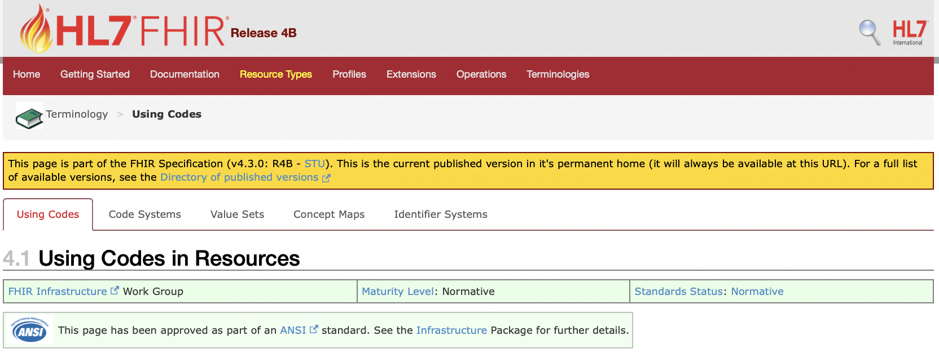
Terminology documentation 2/8
Using codes in resources
Detailed information regarding the use of terminology in FHIR
Addresses
Codes and concepts in FHIR
Code systems and value sets in FHIR
Choosing a code system
Complex code systems
Controlling the use of coded values

Slide 49
Terminology documentation 3/8
Codes and concepts in FHIR
The FHIR framework for using coded values is based on the fundamental framework as defined in section 5 of the HL7 V3 Core Principles document, including the separation between code systems and value sets.
In FHIR, coded values are always treated as a pair composed of "system" (code system identifier) and "code", where the system is a URI (ideally a URL) that identifies the code system that defines the codes.
System values are always case sensitive. Different code systems make their own rules as to whether the codes they define are case sensitive or not.
All the codes defined by FHIR itself are case sensitive and SHALL be used in the provided case (usually, but not always, lowercase).

Slide 50
Terminology documentation 4/8
Codes and concepts in FHIR
The general pattern for representing coded elements is using the following four elements:
Element | Description
system | A URI that identifies the system
version | Identifies the version of the system
code | A string pattern that identifies a concept as defined by the code system
display | A description of the concept as defined by the code system

Slide 51
Terminology documentation 5/8
Code systems and value sets in FHIR
IMPORTANT DISTINCTION
CodeSystem resources define concepts and give them meaning through formal definitions, and assign codes that represent the concepts
ValueSet resources specify a set of codes defined by code systems that can be used in a specific context
This separates
The definition of a concept (in the code system) from
The use of the concept (in the value set)

Slide 52
Terminology documentation 6/8
Controlling the use of coded values
Valid codes for coded values are controlled through a mechanism referred to as binding
A value set is said to be bound to a data element if the specification defines that data element with a binding to that value set.
Bindings are described through the following properties:
name — a descriptive name for the binding
strength — how the binding should be understood
reference — the URI of the value set being bound
description — a text description of the use of the codes
In FHIR bindings are specified using the ElementDefinition.binding data element
A
B
C

Slide 53
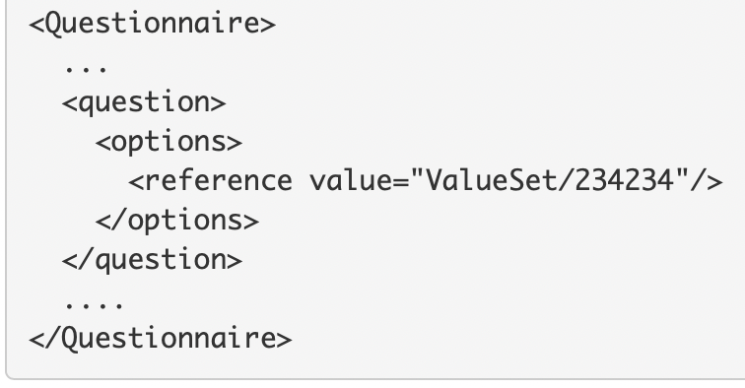
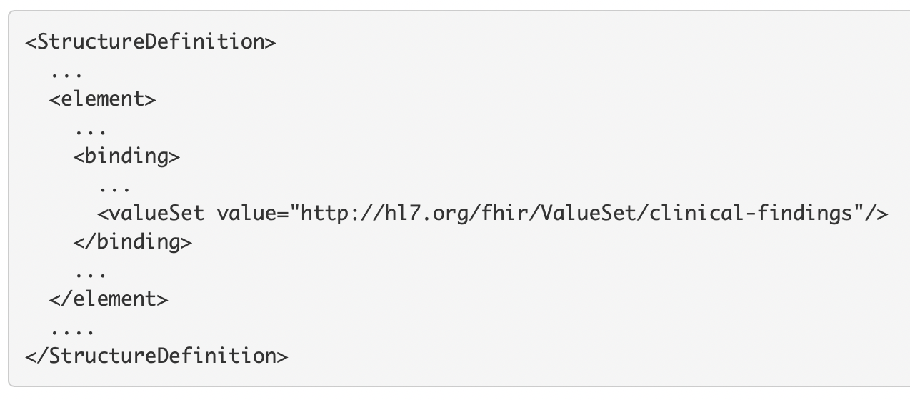
Terminology documentation 7/8
Controlling the use of coded values — Value set references
The are two ways to reference value sets
Direct reference — this uses a FHIR Reference data type to refer to a ValueSet available from a URL on a FHIR Server accessible via the FHIR RESTful API
Logical value set references — this uses a FHIR canonical data type where an absolute URI which matches the ValueSet.url value of the value set itself is provided.
Logical value set references (the canonical data type) may also be version specific e.g.
http://hl7.org/fhir/ValueSet/clinical-findings|0.8

Slide 54
Terminology documentation 8/8
Controlling the use of coded values — Binding strength
When a data element is bound to a value set, the binding strength asserts how closely the value set should be followed to remain conformant
FHIR supports the following binding strengths from most to least restrictive
required — this element SHALL have a value from the specified value set
extensible — this element SHALL have a value from the specified value set if any of the codes within the value set can apply to the concept being communicated. If the value set does not cover the concept (based on human review), alternative concepts may be included instead
preferred — the element is encouraged to have a value from the value set for interoperability purposes but are not required to do so to be considered conformant
example — the element is not expected or even encouraged to have a value from the specified value set. The value set merely provides examples of the types of concepts intended to be included
A
B
C

Slide 55
The FHIR Terminology Service

Slide 56
The FHIR Terminology Service 1/3
Overview
The FHIR specification includes support for the provision of a terminology service — http://hl7.org/fhir/terminology-service.html
At a high level, the FHIR Terminology Service is described as a service that allows healthcare applications to meaningfully use codes, value sets and concept maps without requiring expertise in the underlying code systems and their terminological principles.
The FHIR Terminology Service is defined as a FHIR server which is required to support a minimum set of functionality including support for a minimum set of terminology resource types, the RESTful API, terminology operations.
Effectively, the complexity of terminologies can then be delegated to a terminology service which makes it easy for applications to access and use the terminologies through an Application Programming Interface (API)

Slide 57
The FHIR Terminology Service 2/3
The FHIR Terminology Service — required functionality.
The following are the minimum requirements for a FHIR Terminology Service
All the standard requirements for a FHIR Server e.g., the Capabilities interaction
Terminology resources
CodeSystem, ValueSet and ConceptMap
RESTful API
Search for CodeSystem, ValueSet and ConceptMap
Operations
$expand, $lookup, $validate-code (Value Set), $subsumes, $translate, $closure
Batch interaction for $translate and $validate-code (Value Set)
NOTE: The minimum requirements for a FHIR Terminology Service have been significantly updated in FHIR R5

Slide 58
The FHIR Terminology Service 3/3
The FHIR Terminology Service — usage scenarios.
Usage scenario | FHIR Terminology Service solution
Obtain a list of codes to populate a user interface widget e.g., a dropdown list. | Invoke the $expand operation with the value set (which contains the codes) as the input parameter
Obtain a list of codes based on what the user has typed in a user interface text box | Invoke the $expand operation with the value set (which contains the codes) and the text the user has entered as the input parameters
Determine if a received code is valid. | Invoke the $validate-code operation with the received code as the input parameter
Obtain the display names (descriptions) for a code to display them in a user interface ? | Invoke the $lookup operation with the received code as the input parameter
Obtain a translation of a concept in one code system to a concept in another code system. | Invoke the $translate operation with the source code and a concept map as the input parameters

Slide 59
Additional TOPICS

Slide 60
Additional topics
Introduction to HL7 Terminology — http://terminology.hl7.org (THO)
HL7 Terminology
Is an HL7 service provided as a publicly accessible web site
Represents a new way for HL7 to publish its terminology artefacts, which were previously contained within various standards and guides in the different HL7 product families
Is managed by the HL7 Terminology Services Management Group (TSMG)

Slide 61
Additional topics
Introduction to the HL7 Unified Terminology Governance (UTG)
UTG is
The HL7 process for governance and maintenance of the vocabulary published in HL7 Terminology (terminology.hl7.org)
Employs a community-wide, consensus-based, continuous process for updates to the terminology
Relies upon JIRA to manage change requests and employs voting by terminology experts from across HL7
Jira UP issues
Managed by the TSMG

Slide 62
Questions?
Connect with the FHIR community: FHIR Zulip chat terminology stream
https://chat.fhir.org/#narrow/stream/terminology
Or ask me: Rob Hausam
rob@hausamconsulting.com

